Slide 1

28th Worthing Beer & Cider Festival
WELCOME
Notes:
ID=d924773e-9a16-4d6d-9803-8cb819e99682
Recipe=text_billboard
Type=TextOnly
Variant=0
FamilyID=AccentBoxWalbaum_Zero

Slide 2
We hope you enjoy our festival
Try Incredible Beers
Meet Our Charity
Online Beer List
This year we are showcasing beers from Sheffield Brewers
Care for Veterans are here, please make them welcome and donate.
We hope you have a good event, and our volunteers are here to help you have a great time
As well as our programme, a digital list is available where you can search by beer styles, and ABV’s as well as links to the Brewers websites.
Taste Great Food
Have a Great Event
Our caterer is Humble Pie, They also have soft drinks, wine and gin & tonic

Slide 3
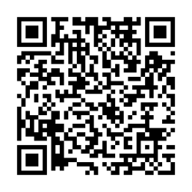
Online Beer List
Search by ABV or Beer Style, Gluten Free & Vegan Beers
See the Tasting Notes
Visit the Brewers website
Check in Untapdd
Scan the QR to load the Online Beer List

Slide 4


Slide 5



UnBarred
Thank you to our sponsors, UnBarred we are very grateful for their support.
Look out for these beers on the Cask and Keg Bar !
Casual Pale
Extra Pale
Fruit Riot

Slide 6





Have you tried our Sheffield Brewers?

Slide 7

Care for Veterans
We are proud to be supporting Care for Veterans, a Royal Star & Garter home.
Established in 1919 to support soldiers returning from the First World War with life-changing disabilities, Care for Veterans has been providing specialist care for over 100 years. Today, the charity provides expert nursing care, rehabilitation, respite and day care, alongside in-house physiotherapy, occupational therapy and wellbeing activities, helping veterans live fulfilling lives with dignity and independence.
You can donate at their stall direct, or if you have any leftover tokens, they can be donated via the charity collection box by the exit.

Slide 8





Have you tried our local breweries?

Slide 9

Hungry?
Pies
Sussex Steak & Ale
Chicken, Ham Hock, Leak & Cheddar
Sussex Pork, Cider & Black Pudding
Butternut Squash, Roast Garlic & Red Pepper (VE)
Hot & Cold Scotch Eggs
Traditional Pork Pies
Harvey’s Beer Hop Sausage Rolls
Gluten Free options available
Also wine, gin & tonic and soft drinks

Slide 10





Have you tried our Cider Bar?

Slide 11
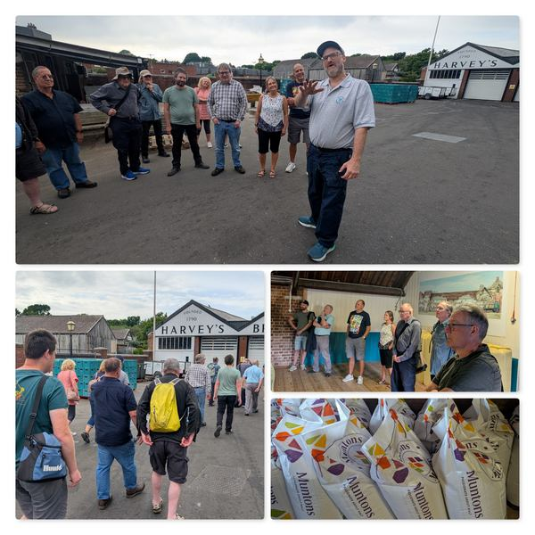
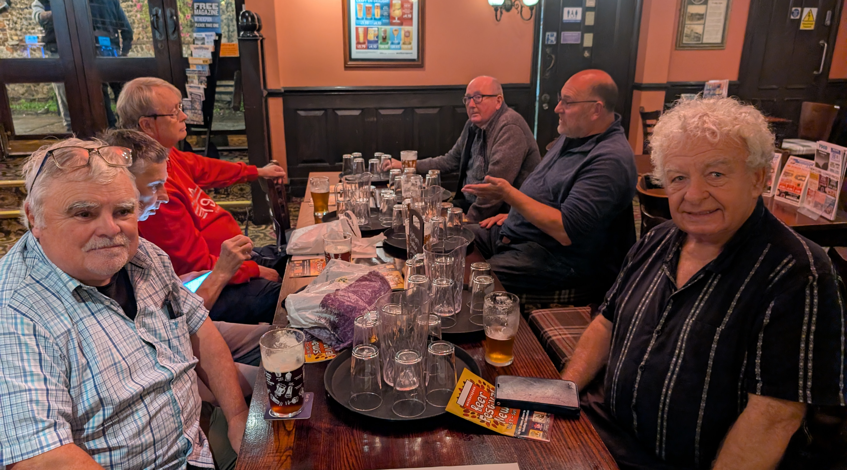
Arun & Adur CAMRA
What do we do?
Hold Socials and Ale Trails
Support Local Pubs
Brewery Tours
Survey Pubs for the Good Beer Guide
Organise Worthing Beer And Cider Festival
Have lots of fun.

Slide 12
Become a Member
Join at this Festival !!
How do I Join?
What does it Cost?
Get you entry back in tokens at this festival !
Free Entry to all CAMRA Festivals
Receive CAMRA Ale and Cider Discount Vouchers (by Post)
Ask at the Membership Stand
Ask at the Beer Tokens Stand
Our volunteers will find someone with a tablet to sign you up.
£35 Single Membership
£43 Joint Membership

Slide 13
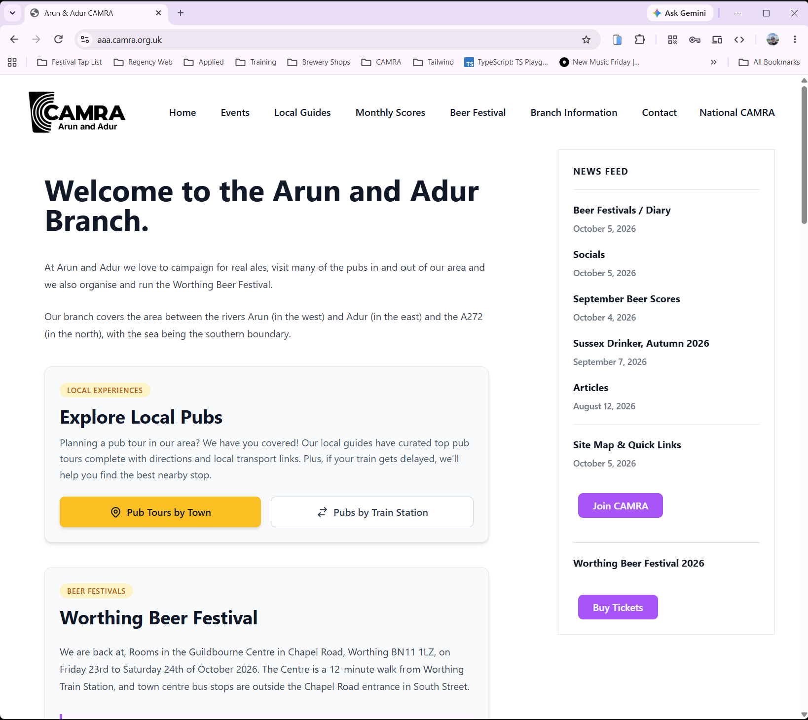
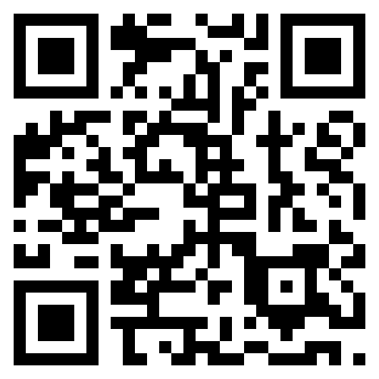
Check out our Website
Here you will find:
Listings of local Beer Festivals
Ale Trails by foot or public transport
Meet the Publican, showcasing pubs in our area
Beer scores
Details of upcoming socials
and more…
https://aaa.camra.org.uk

Slide 14


Replacement Beers to Find
Verdant - Lightbulb (39)
Long Man – Plum Porter (11)

Slide 15
Thanks to all our volunteers who made this festival possible
Arun and Adur CAMRA Committee Members

Slide 16
Don’t forget to…
Vote and Share your Comments
Any Tokens Left?
Return your Glass
Please complete your vote slip to show your favourite beer and/or cider of the festival and provide any feedback.
Box is by the Exit.
These can be donated to Care for Veterans. Tokens will be counted up and the money donated direct to the charity.
Box is by the Exit.
To reduce waste and keep costs low, we are renting glasses for the event.

